Slide 1
MOVIE TICKET DATABASE
DBMS MINI PROJECT REPORT

Slide 2

ABOUT
ABOUT

Slide 3

ABOUT
This project aims to help the management in theatres to add, update, display, delete the movie info using SQLite for the backend and Tkinter for the frontend to display the movie information

Slide 4

PROBLEM
The conventional movie theatre requires complicated process to update or delete information about a movie.
It is hard to keep accurate tallies of the current status of movies.

Slide 5
ABOUT
SOLUTION

Slide 6
SOLUTION
We have developed an integrated frontend and backend system that makes it easy for the management to keep track of movie information and allow functionalities like updating, deleting, etc,.

Slide 7
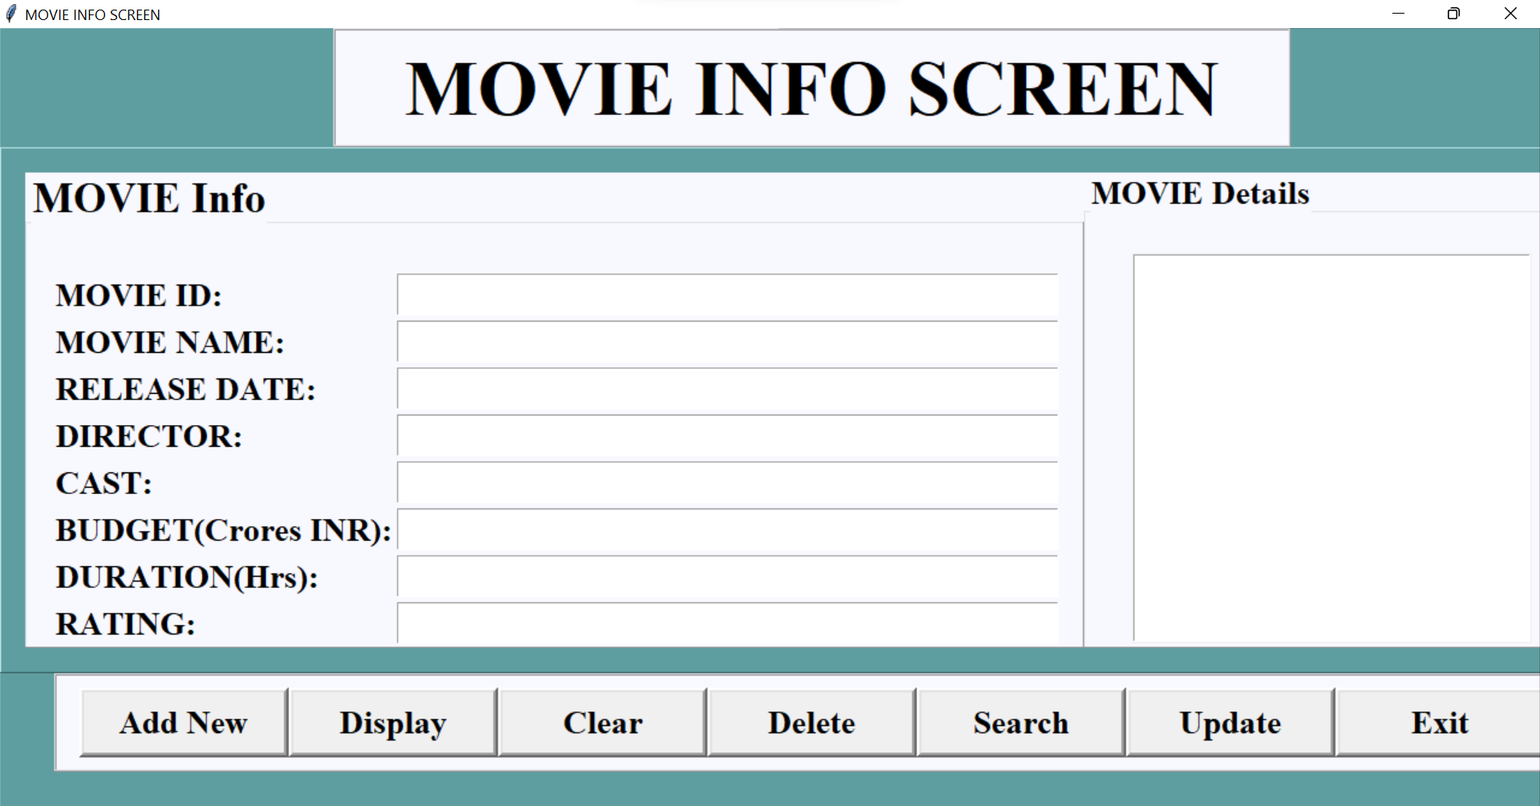
FRONTEND
We used tkinter for the frontend.
We added add new for adding new information, display, clear for clearing information, delete, search, update and exit keys to add the movies information.

Slide 8
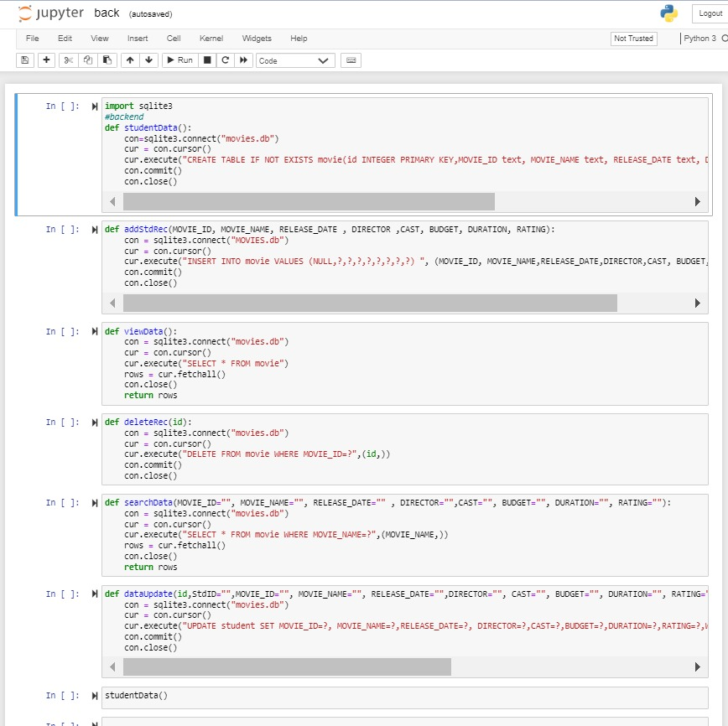
BACKEND
We have used SQLite integrated with tkinter framework
Functionalities like search, delete, update, add new and clear are executed using SQLITE.

Slide 9
OUR TEAM
U BRUNDA
PALAKURU AKHILESH
KANNA PREM CHAND
RA1911032010037
RA1911032010055
RA1911032010042

Slide 10
THANK YOU

